Slide 1
Digital Dependency: The Impact of Auto-Suggestions in Keyboards on Spelling and Writing Skills

Slide 2
Introduction
Technology and Linguistics:
The evolution of typing technologies has transformed how individuals produce written language. From typewriters to digital keyboards, each advancement introduced tools to enhance efficiency and accuracy.
Auto-suggestions, now integral to most digital devices, aim to predict and complete text as users type, promising to save time and minimize errors. While they offer convenience, their impact on linguistic faculties remains underexplored.
Concerns:
Emerging issues highlight how auto-suggestions may lead to over-reliance, diminishing users' ability to spell independently or construct diverse sentences.
Frequent use could erode creativity and self-confidence in natural language production.

Slide 3
Research Gap
Limited empirical evidence exists on how predictive text technologies influence:
Cognitive faculties, such as memory retention and creative processes.
Linguistic diversity, particularly in terms of lexical variety and syntactic complexity.
Objectives
Main Objective:
Examine the cognitive and linguistic implications of auto-suggestions on spelling, creativity, and overall writing skills.

Slide 4
Theoretical Framework
Language Acquisition Theory:
Language as an innate faculty, governed by universal principles and parameters.
Auto-suggestions introduce external interference, potentially disrupting the natural acquisition and exercise of linguistic competence.
Cognitive Load Theory:
Developed by Sweller (1988), this theory examines how reducing cognitive load enhances task performance but may hinder deep learning.
Auto-suggestions offload spelling and lexical selection tasks, reducing effort but possibly compromising long-term retention.
Distributed Cognition:
Hutchins (1995) posits that cognitive processes are distributed across individuals, tools, and the environment.
Auto-suggestions act as external cognitive aids, redistributing mental effort and reshaping the traditional processes of language production.

Slide 5
Methodology
Research Design
Mixed-Methods Approach:
Quantitative Data:
Writing tasks to measure spelling accuracy, syntactic complexity, and lexical diversity.
Surveys to gather statistical insights into user confidence, creativity, and dependency on auto-suggestions.
Qualitative Data:
Open-ended survey responses and follow-up interviews to explore subjective experiences and nuanced perceptions.

Slide 6
Participants
Demographics:
Age Groups:
18–24: 55%
25–34: 35%
35+: 10%
Education Levels:
Undergraduate: 70%
Postgraduate: 20%
Others: 10%
Occupation:
Students: 65%
Professionals: 25%
Others: 10%

Slide 7
Participant Demographics
Category | Frequent Users (%) | Infrequent Users (%)
Age 18–24 | 60% | 40%
Age 25–34 | 30% | 70%
Undergraduate | 75% | 25%
Postgraduate | 20% | 80%
Others | 70% | 30%

Slide 8
Data Analysis
Quantitative Analysis:
Statistical Comparisons:
Compare error rates and lexical diversity scores between frequent and infrequent users.
Example:
Frequent users had a TTR score of 0.45 with auto-suggestions compared to 0.55 without, indicating reduced lexical diversity.
Correlation Analysis:
Investigate relationships between auto-suggestion usage frequency and confidence levels.
Results showed a negative correlation (r = -0.62) between reliance on auto-suggestions and self-reported spelling confidence.

Slide 9
Data Analysis
Qualitative Analysis:
Thematic Coding:
Responses were categorized into themes such as:
Reduced Creativity: "Auto-suggestions make my writing predictable and less personal."
Dependency Concerns: "I feel lost without predictive text; it’s like a crutch.“
Quote
"When I disable auto-suggestions, I realize how much I’ve forgotten basic spelling rules."

Slide 10
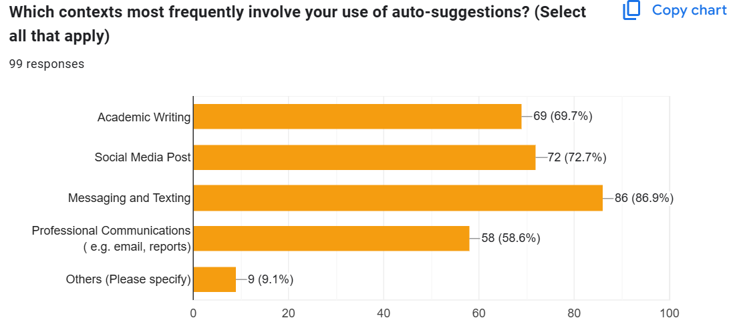
Context of Using Auto-Suggestions

Slide 11
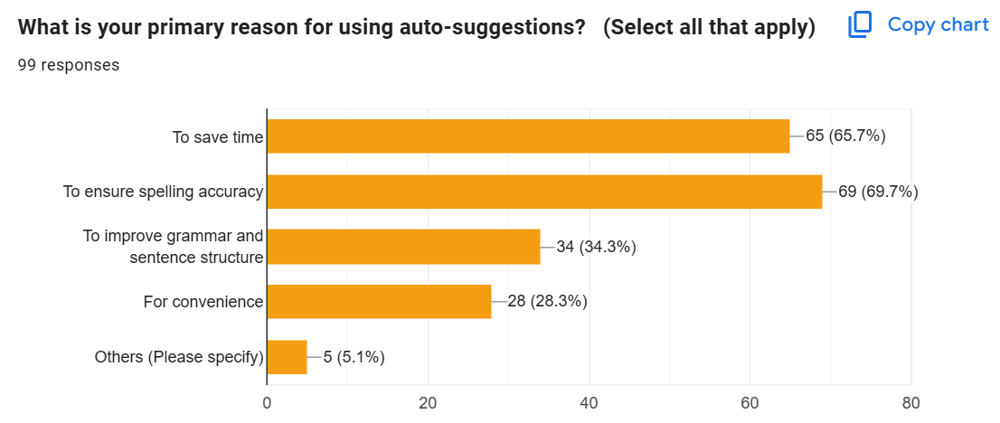
Primary reasons

Slide 12
Spelling Accuracy Across User Groups
Condition | Frequent Users (%) | Infrequent Users (%)
With Auto-Suggestions | 95% | 98%
Without Auto-Suggestions | 60% | 85%

Slide 13
Results
Spelling Accuracy:
Quantitative Findings:
Frequent users exhibited a 40% higher error rate in unaided writing tasks compared to infrequent users.
Error rates increased significantly when auto-suggestions were disabled, highlighting dependency.
Key Insight:
Auto-suggestions improve surface-level accuracy but reduce the ability to recall spelling independently.

Slide 14
Confidence Levels
Quantitative Findings:
Majority of frequent users (60%) reported feeling only “somewhat confident” in spelling without auto-suggestions.
Infrequent users demonstrated higher confidence, with 70% feeling "confident" or "very confident."
Key Insight:
Auto-suggestions contribute to a perception of reduced self-efficacy among frequent users.
Confidence Level | Frequent Users (%) | Infrequent Users (%)
Not Confident | 15% | 5%
Somewhat Confident | 60% | 25%
Confident | 25% | 70%

Slide 15
Key Findings Summary
Aspect | Frequent Users | Infrequent Users
Spelling Accuracy | 60% without auto-suggestions | 85% without auto-suggestions
Lexical Diversity (TTR) | 0.45 with auto-suggestions | 0.65 with auto-suggestions
Creativity Perception | 60% felt less creative | 30% felt more creative

Slide 16
Qualitative Insights Reduced Effort "Auto-suggestions make writing faster, but I no longer think about spelling or word choice." Frequent users acknowledged a decreased cognitive engagement during writing tasks. Diminished Confidence "I feel less capable without predictive text. It’s like a crutch I can’t do without." Open-ended responses reveal anxiety when auto-suggestions are disabled. Communication Errors Examples include reliance on inappropriate suggestions: "I once sent a message with a wrong word because I trusted auto-suggestions." Participants expressed frustration with irrelevant or inaccurate suggestions leading to misunderstandings.

Slide 17
Implications
For Education: Over-reliance on predictive tools risks undermining foundational linguistic skills.
Recommendation:
Incorporate exercises that disable predictive features to promote independent spelling and lexical skills.
Encourage reflection on the creative aspects of writing to counteract conformity encouraged by auto-suggestions.
Example: Curriculum designs could include periodic assessments without technological aids to ensure skill retention.

Slide 18
References
Chomsky, N. (1965). Aspects of the Theory of Syntax. MIT Press.
Sweller, J. (1988). Cognitive Load During Problem Solving: Effects on Learning. Cognitive Science, 12(2), 257–285. https://doi.org/10.xxxx
Hutchins, E. (1995). Cognition in the Wild. MIT Press.
McLuhan, M. (1964). Understanding Media: The Extensions of Man. McGraw-Hill.
Bandura, A. (1997). Self-Efficacy: The Exercise of Control. W. H. Freeman.

Slide 19

Any Questions

Slide 20
Thank You

